Slide 1

NEXUX BANK Customer Segmentation and Deposit Detection System
OLUWASEUN AFOLABI
Cohort 12

Slide 2
Aim & Objectives of the Project
Objectives:
Data Preprocessing
Perform EDA to gain insights and understand the characteristics of the customer data.
Customer segmentation to categorize customers based on demographics, behavior, and other relevant factors using KMeans Clustering.
Build deposit detection models using machine learning algorithms to predict & identify patterns associated with customer deposits:
XGBoost, Random Forest, Gradient Boosting Machine, K-Nearest Neighbors, Support Vector Machine, Decision Tree, Logistic Regression, Naive Bayes.
Evaluate the performance of the system (Accuracy, precision, & recall) to ensure its effectiveness in segmentation and deposit detection.
To develop a customer segmentation and deposit detection system for Nexux bank to enhance marketing strategies and identify potential deposit patterns.

Slide 3


Benefits of the Customer Segmentation & Deposit Detection System
The key benefits Nexux bank will derive from this project include:
Enhanced marketing strategies based on customer segmentation
Targeted marketing campaigns
Identification of deposit patterns
Increased customer satisfaction
Better utilization of resources
Improved decision-making
Competitive advantage
Increased revenue and profitability

Slide 4
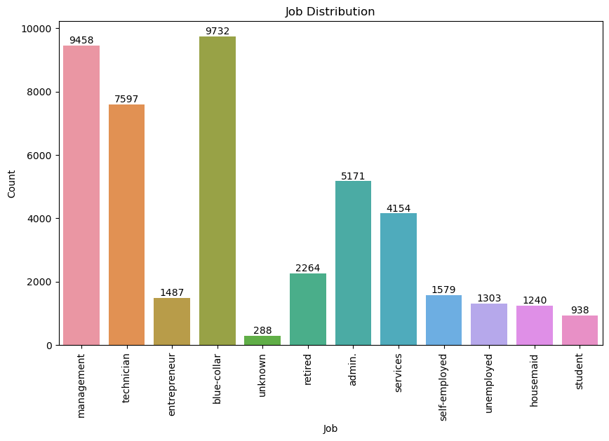
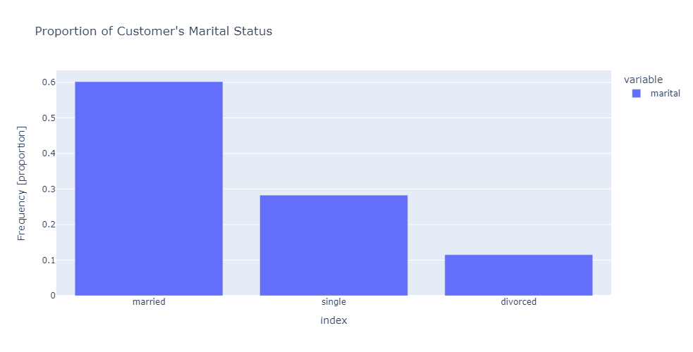
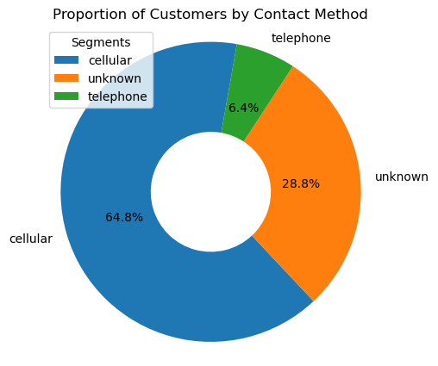
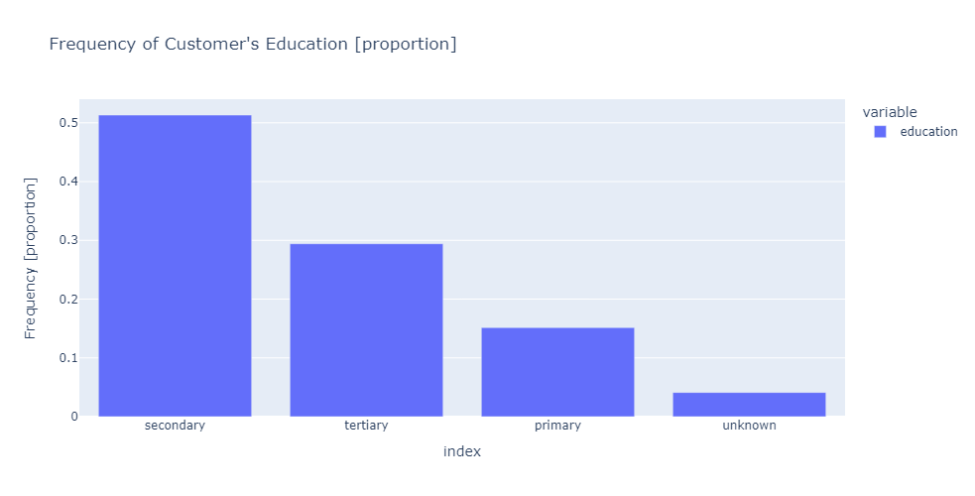
Exploratory Data Analysis (Univariate)
Insights from Data
Most of the customers are doing blue-collar job followed by management and technician jobs.
About 60% of customers are married while 28% are single and the remaining close to 11% are divorced.
Most of the customer's highest education level is secondary. About 51% of customers have their education at secondary level, followed by customers with tertiary level of education, then primary. The education level of the remaining 4% is unknown.
65% of the customers were contacted via cellular method, 6% by telephone & 29% by unknown methods.

Slide 5
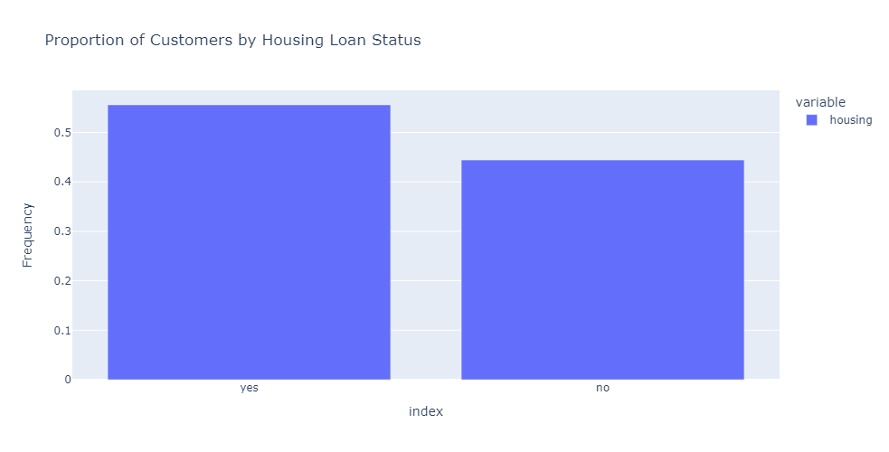
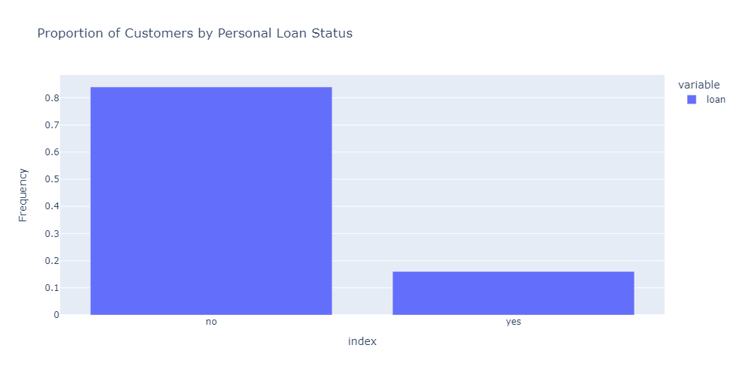
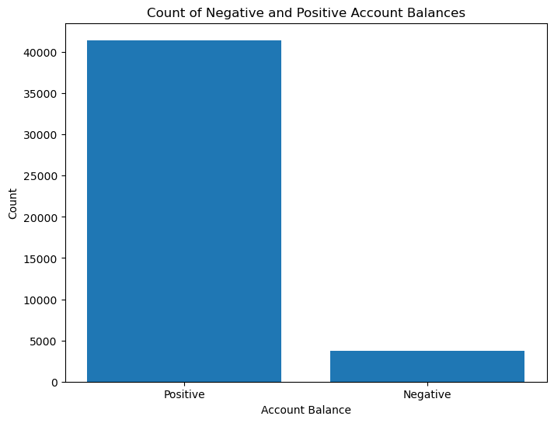
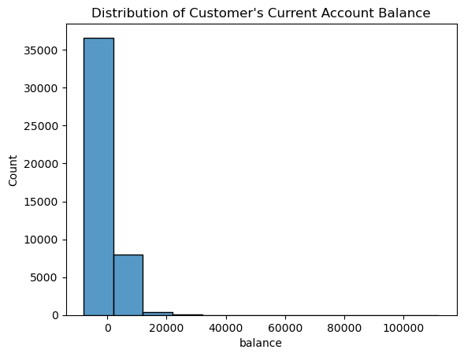
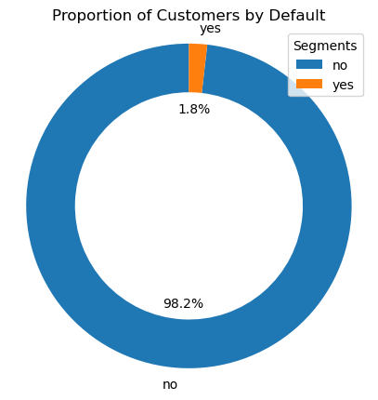
Exploratory Data Analysis (Univariate)
Insights from Data
56% of the customers have housing loan while the remaining 44% do not have.
16% of the customers collected personal loan while the remaining 84% do not.
There are more customers with positive account balance.
Majority of customer's income is within -8 to 20k$.
As shown, just 1.8% of the customers defaulted on loan or credit card payment while about 98.2% did not.
Default feature seems not to play an important role since almost all the customers do not default.

Slide 6
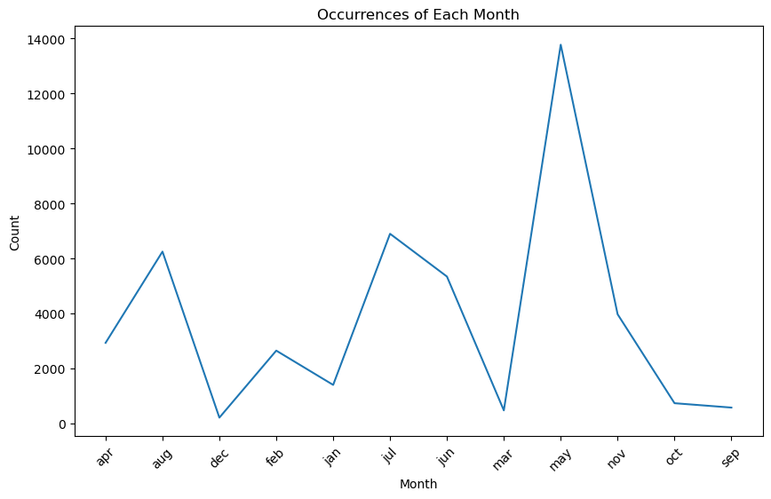
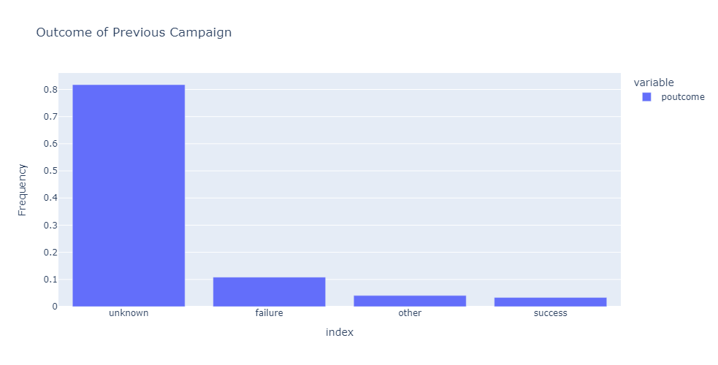
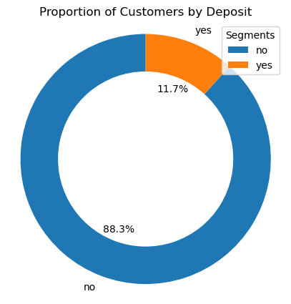
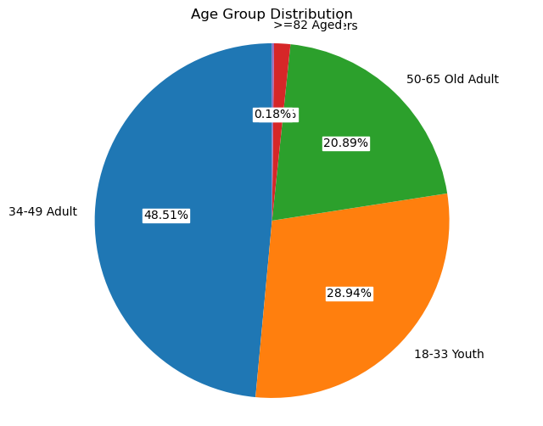
Exploratory Data Analysis (Univariate)
Insights from Data
More customers were contacted in May and the least were in December.
3% success was recorded, 82% was unknown and 11% failure was recorded. The Campaign data collection system (analytics) is not effective at all.
88% of the customers do not subscribe to term deposit while only 12% subscribed to term deposit.
Most of the customers fall in the Adult group (34-49 years old).

Slide 7
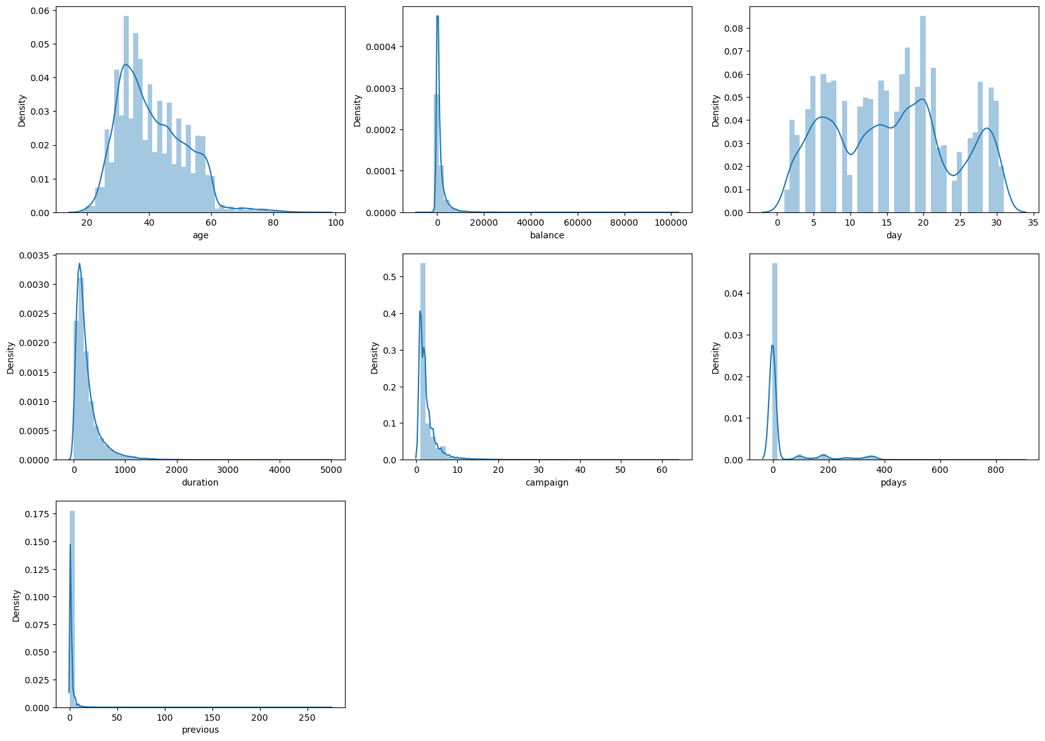
Exploratory Data Analysis (Univariate)
Insights from Data
Age and days are distributed normally.
Others (i.e. balance, duration, campaign, pdays and previous) are heavily skewed towards left and they seem to be have some outliers.

Slide 8
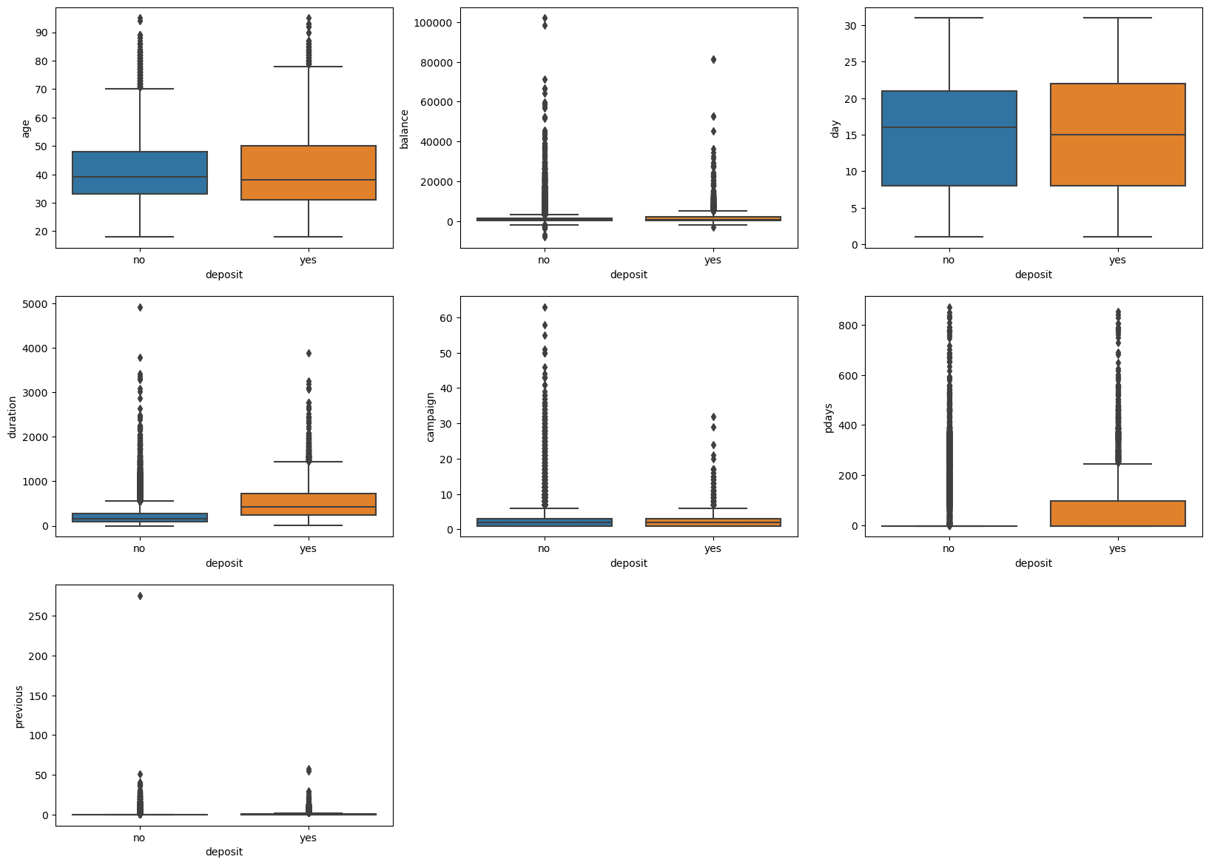
Exploratory Data Analysis (Multivariate)
Insights from Data
Customers whose contact duration are longer showed interest on deposit. Meaning that duration of contact with customers should be increased for better result.
The age, balance, duration, campaign, pdays and previous data have some outliers.

Slide 9
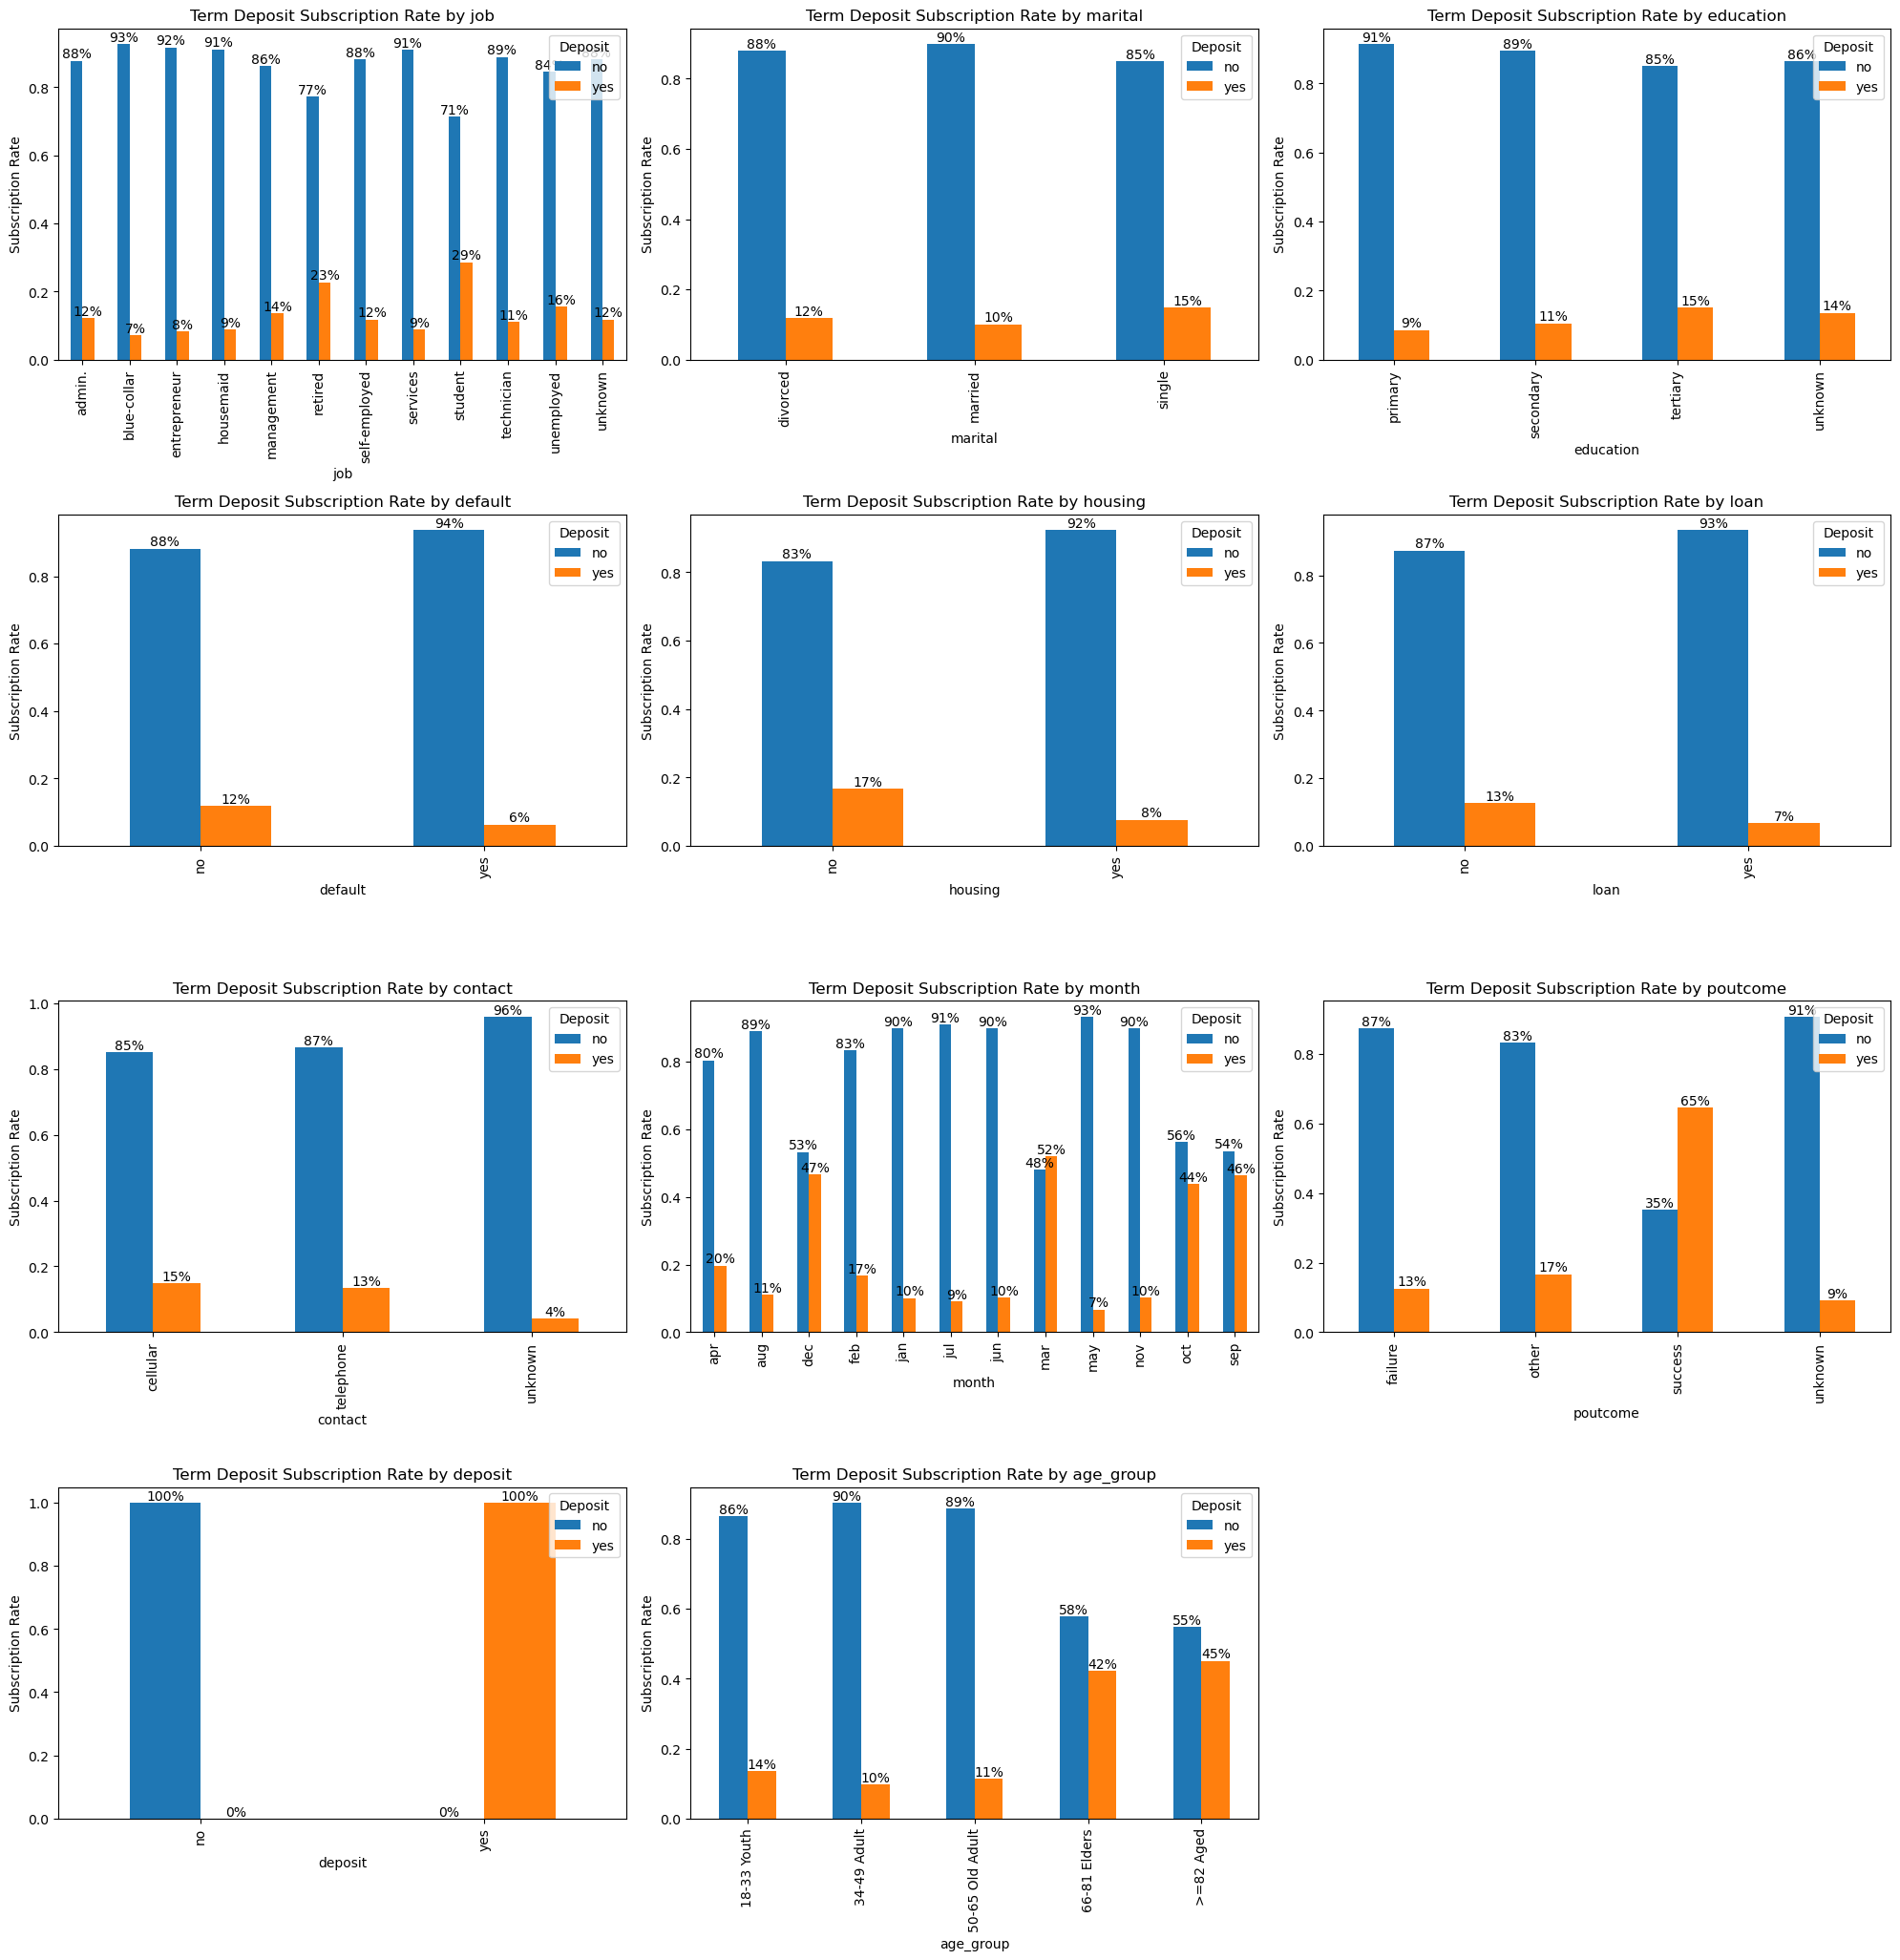
Exploratory Data Analysis (Multivariate)
Insights from Data
Students showed most interest in term deposit followed by the retired customers then the unemployed.
The single customers showed the most interest in deposit followed by the divorced then the married.
Those with tertiary education showed high interest in deposit.
Customers with housing loan have less interest in term deposit.
Those without default showed more interest in term deposit than those with default.
Those without other loans showed more interest in term deposit than those with loans.

Slide 10
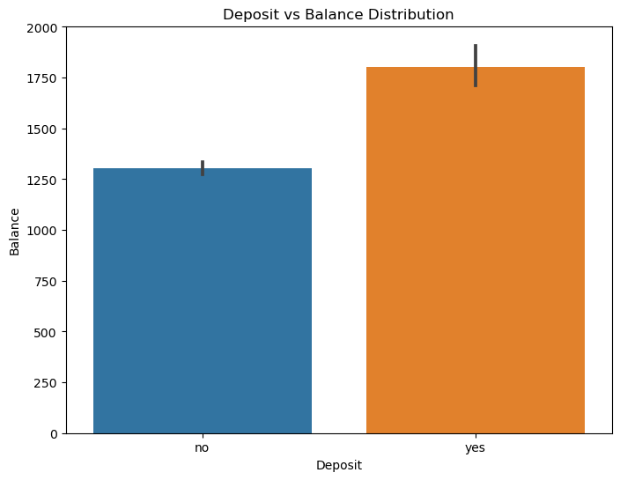
Exploratory Data Analysis (Multivariate)
Insights from Data
Contacted customers showed more interest in term deposit.
Customers showed high interest to term deposit in month of March, September, October & December.
Successful previous marketing produced high chance of customers subscribing to term deposit.
The age group with the highest subscription of deposit (45%) is the age group >=82 followed by the Elders with 42% & then the youth with 14%. The group that showed the least interest in deposit are the adult.
The higher the account balance, the more interest shown by customers to deposit.

Slide 11
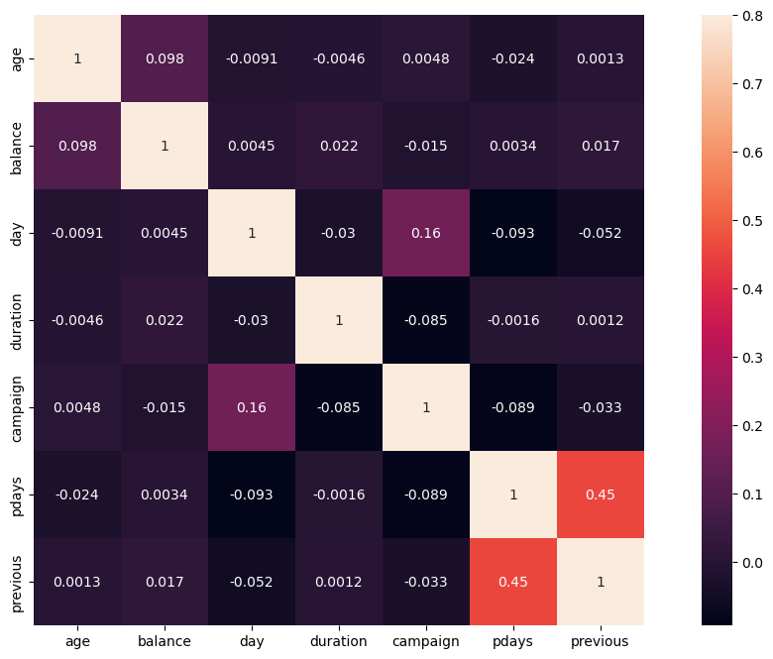
Exploratory Data Analysis (Correlation Matrix)
Insights from Data
There are no strong correlation between the numerical variables.

Slide 12
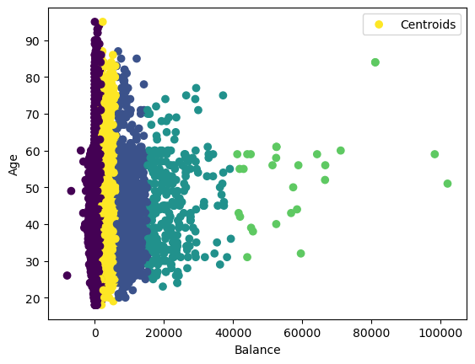
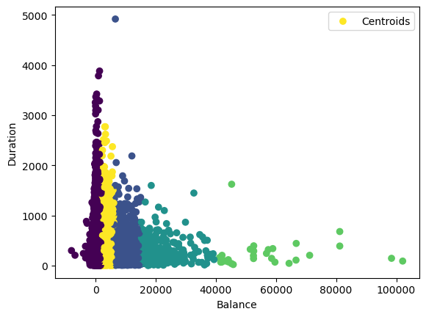
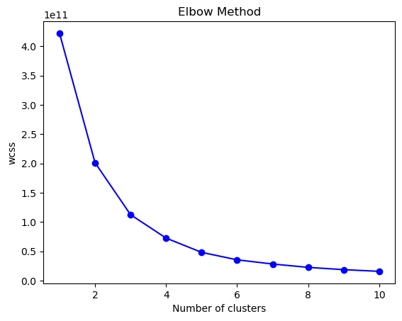
Customer Segmentation
Data Preprocessing
Feature Engineering
Encoding
Data Duplication
Pdays column was dropped because it has about 36954 no of rows with -1 value.
Label encoding was used to convert categorical data into numerical data
Building the Kmean Model
Determine optimal number of clusters

Slide 13
Deposit Prediction
Data Preprocessing
Feature Engineering
Feature Scaling
Independent variable “deposit” column was dropped from the dataset)
Robust Scaler is preferred here as it is more robust to outliers.
Building the Model
Train-Test dataset Split: 70:30
 | Model | Accuracy | Precision | Recall | F1-Score
7 | XGBoost | 0.902610 | 0.893790 | 0.902610 | 0.896874
0 | Random Forest | 0.900251 | 0.887669 | 0.900251 | 0.890876
1 | Gradient Boosting Machine | 0.899808 | 0.885916 | 0.899808 | 0.888742
2 | K-Nearest Neighbors | 0.889487 | 0.871973 | 0.889487 | 0.876732
3 | Support Vector Machine | 0.893173 | 0.872460 | 0.893173 | 0.871947
4 | Decision Tree | 0.870835 | 0.872239 | 0.870835 | 0.871526
5 | Logistic Regression | 0.887423 | 0.861658 | 0.887423 | 0.863301
6 | Naive Bayes | 0.859555 | 0.866340 | 0.859555 | 0.862757
From the table, the best model is XGBoost followed by Random forest, then Gradient boosting machine and so on because of the high accuracy, recall and F1-Score.

Slide 14
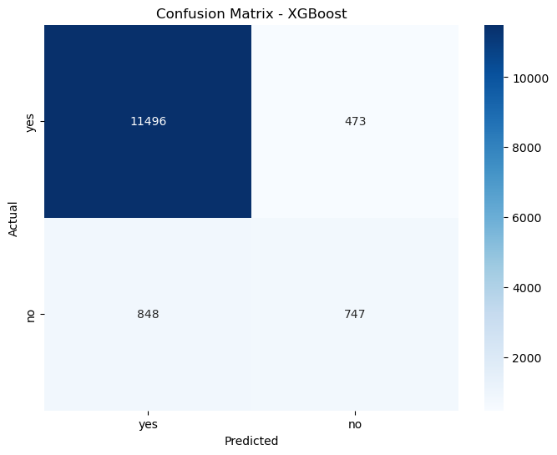
BIG IMAGE
Model Evaluation (Confusion Matrix)

Slide 15
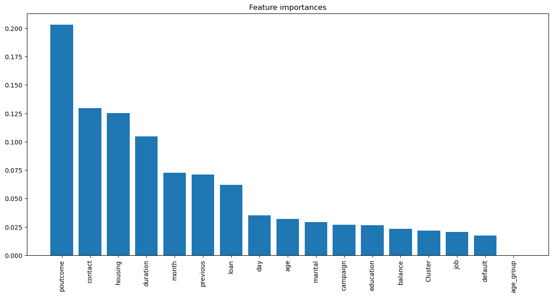
Feature Importance

Slide 16
Recommendation
Marketing campaigns should be encouraged in the month of March, September, October and December, targeting:
The students in tertiary institutions (Age 18-30 years), the retired and the unemployed (Age 66years & above).
Customers without loans and default, and customers with huge account balances
because these set of people tend to save more.
More contact duration of at least 500 seconds (which is the median value of the duration of the last contact with those that subscribed to term deposit) should be spent while following up with the customers.
To attract the Adult and the older adult customer groups, attractive benefits like high deposit commission can be offered by Nexus bank because these set of people tend to spend more and their population is about 62% of the entire customer base.

Slide 17

THANK YOU!

